Slide 1
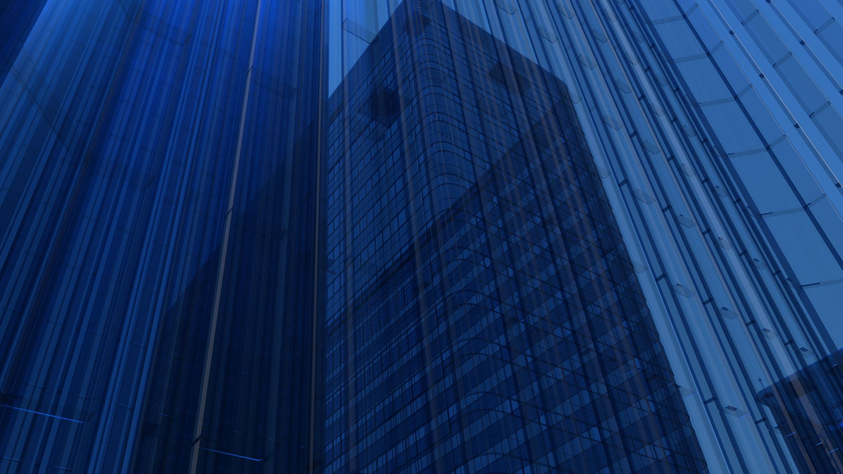
Applications of Graph Coloring 1) Wedding Seating Problem 2) Sudoku

Slide 2

Our team
Kausthub TM – 191IT125
Neeraj Mirji – 191IT232
Puttaraja – 191IT139
Sohanraj R – 191IT149

Slide 3
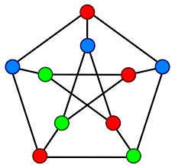
Introduction
Graph coloring : A graph coloring is an assignment of labels, called colors, to the vertices of a graph such that no two adjacent vertices share the same color .
Backtracking : is an algorithmic-technique for solving problems recursively by trying to build a solution incrementally, one piece at a time, removing those solutions that fail to satisfy the constraints of the problem at any point of time . Therefore if the current solution is not suitable, then backtrack and try other solutions.

Slide 4
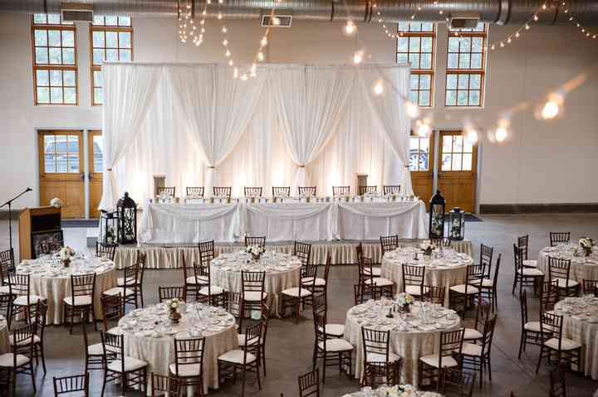
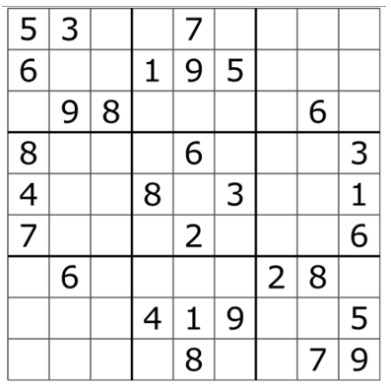
Applications :
Wedding Seating Problem : The Wedding Seating Problem (WSP) involves taking a set of wedding guests and assigning them to tables so that a few constraints are met like two who don’t like each other they should be seated in different tables.
Sudoku : Sudoku is a logic-based, combinatorial number-placement puzzle. In classic sudoku, the objective is to fill a 9×9 grid with digits so that each column, each row, and each of the nine 3×3 subgrids should contain all of the digits from 1 to 9.

Slide 5
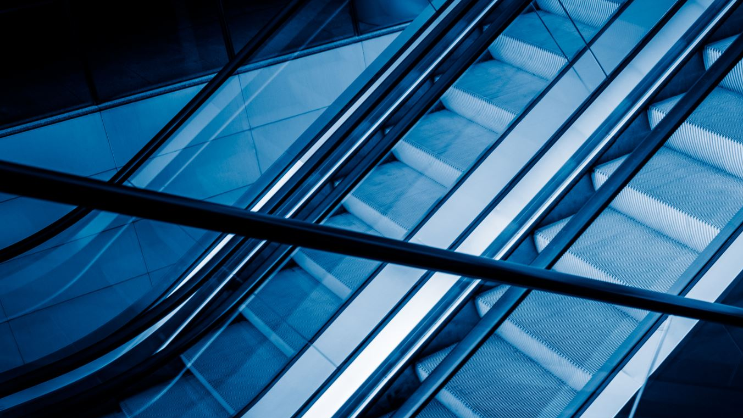
Methodology
Let’s dive in

Slide 6
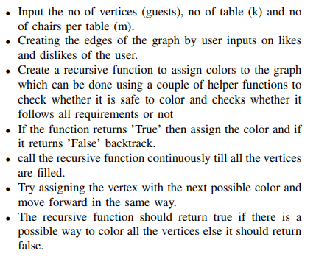
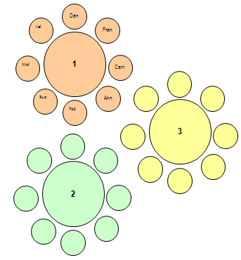
Wedding Seating Problem
The Wedding Seating Problem can be seen as graph coloring problem where each guest is equivalent to a vertex/node and the guests can be grouped in tables by assigning same colors to them. If two guests does not like to seat next to each other then we can create an edge between them so that they are assigned with different colors since no two adjacent vertices of the graph can have the same color as per the concept of graph coloring.

Slide 7
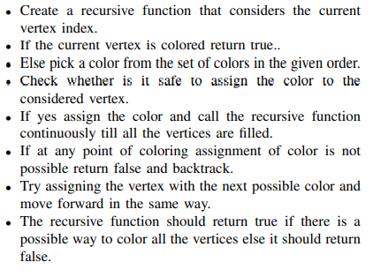
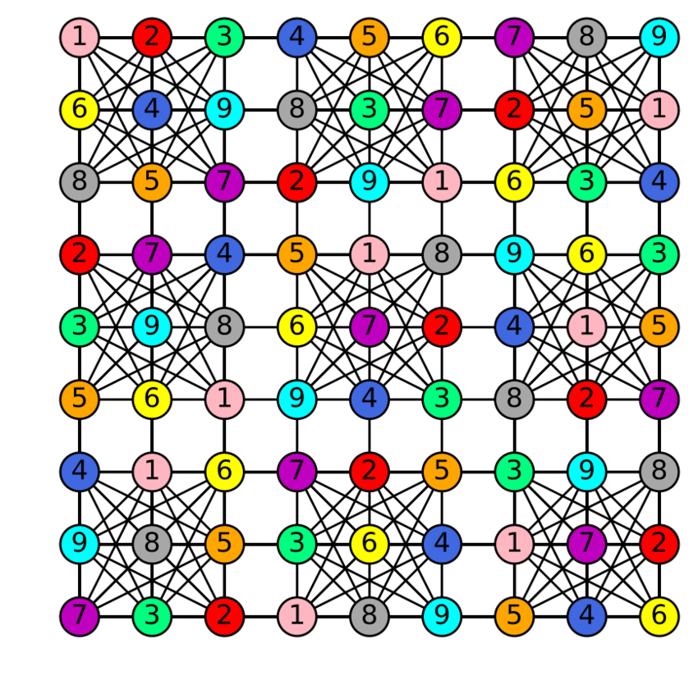
Sudoku
We consider all the cells as the nodes in the graph and all the cells in the given row , column and the 3 x 3 grid as the neighbors of that particular cell i.e. the neighboring cells are directly connected to the considered cell using a edge. The main idea is to assign colors to all the different vertices one by one starting from the vertex 0 and before we assign a given color to a vertex we must make sure that none of the nodes that are directly connected to the given node have been assigned the same color. If there is any color assignment that does not violate the rule, mark the color as the part of the solution. If at any point time the assignment of color is not possible we should backtrack and try with different colors that are available to us.

Slide 8
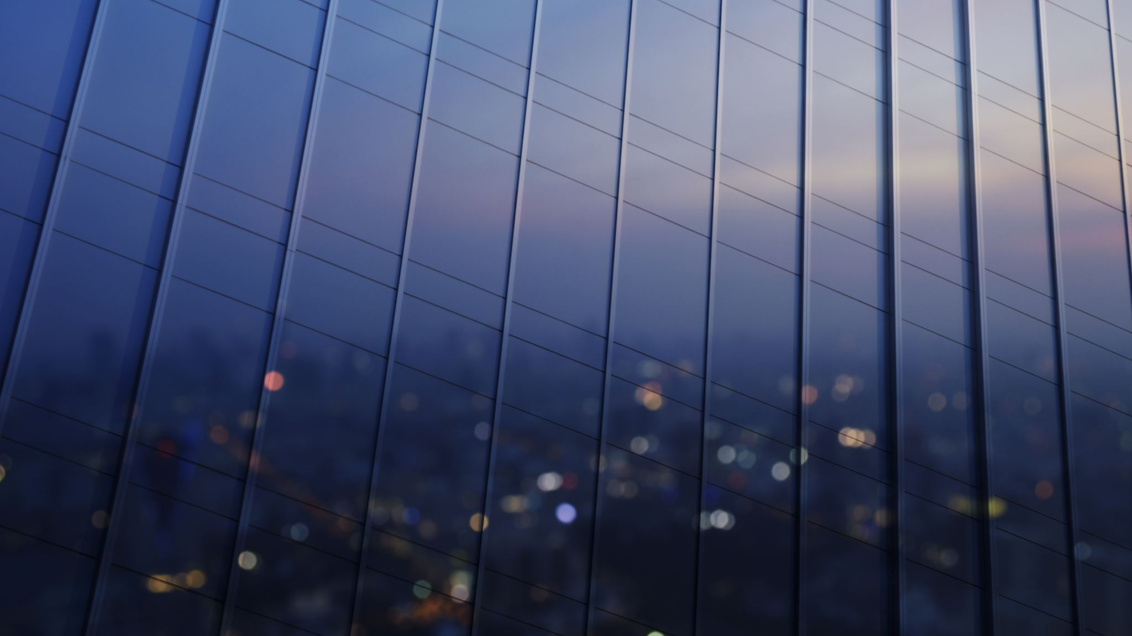
Results and analysis
Let’s dive in

Slide 9
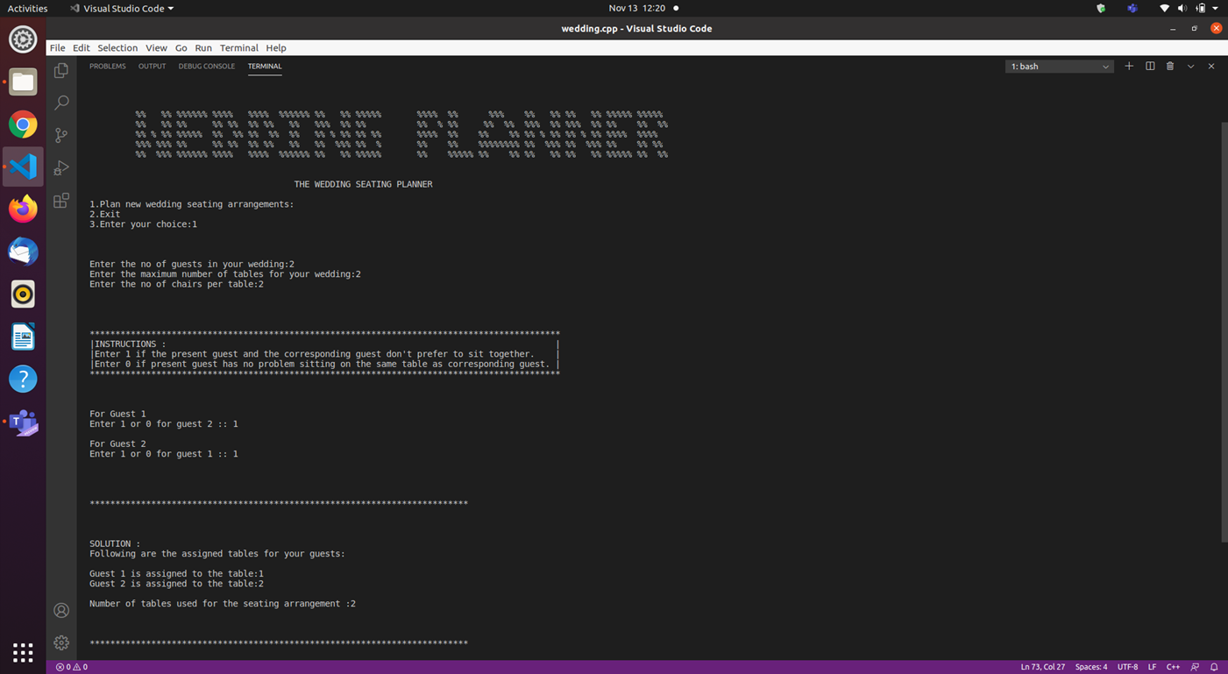
Wedding Seating Problem
Test case where there are two guests and they do not want to seat next to each other with max two tables available :

Slide 10
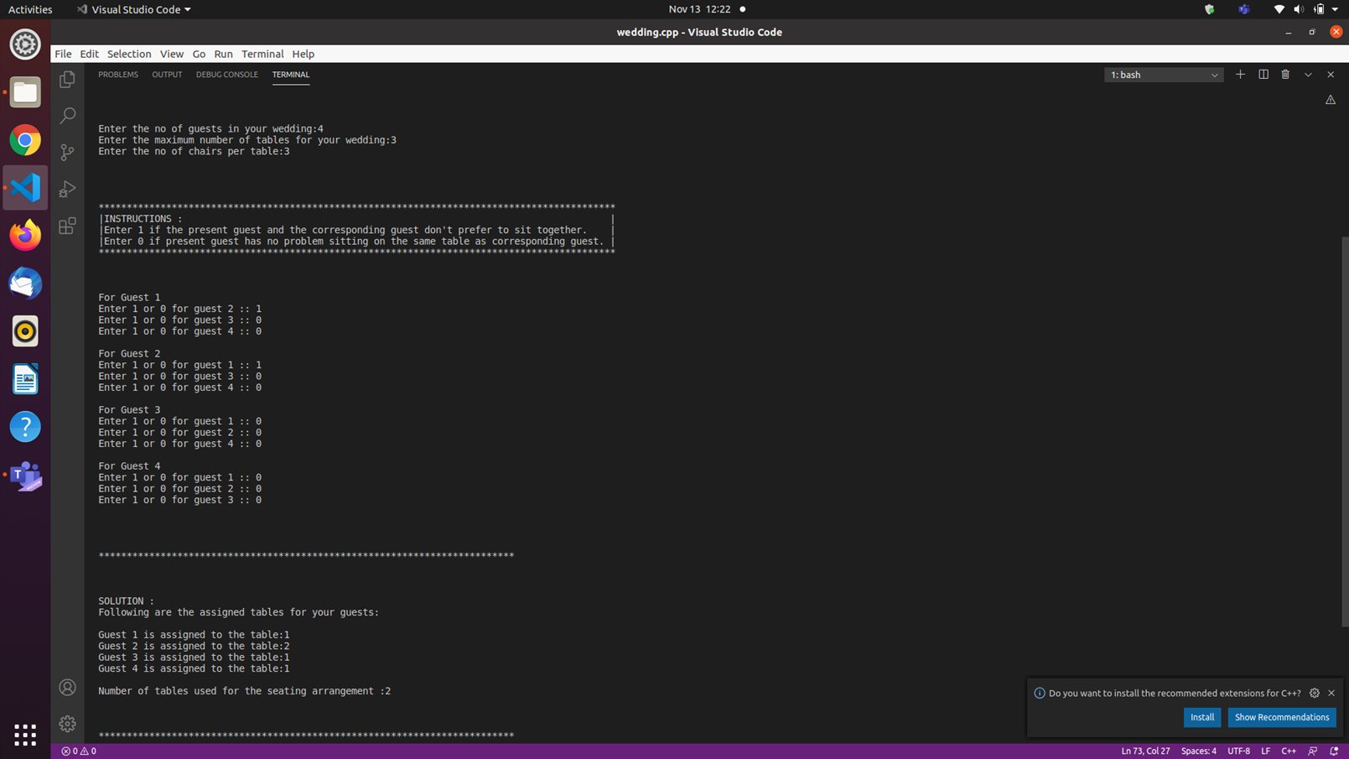
Test case similar to the previous one but with four guests :

Slide 11
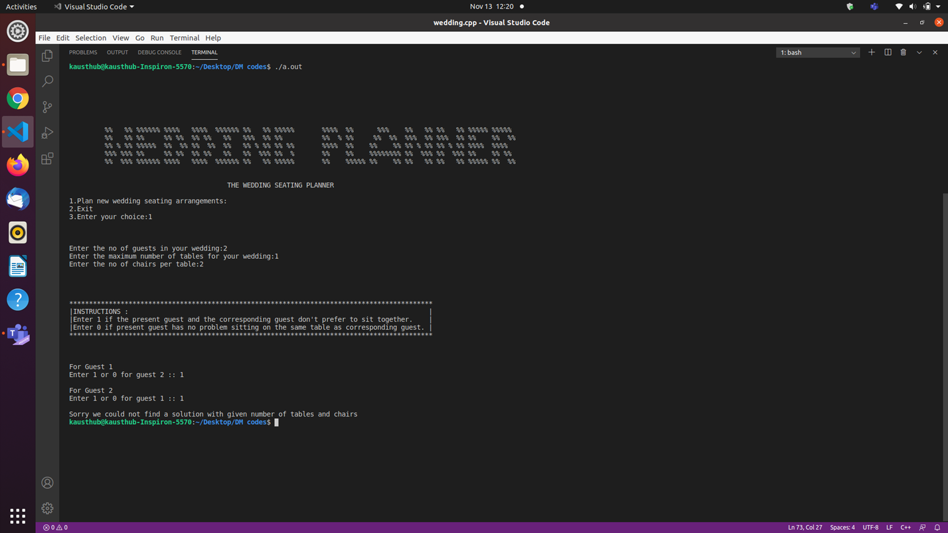
Test case where there are two guests who don’t like to sit next to each other with only one table available i.e. a test case where there is no solution.

Slide 12
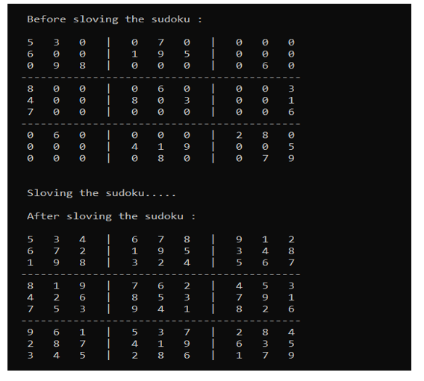
Sudoku
Test case where solution exists :

Slide 13
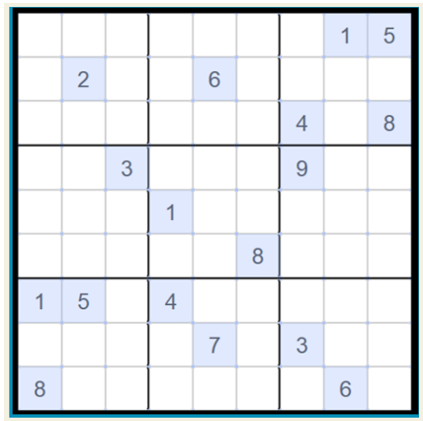
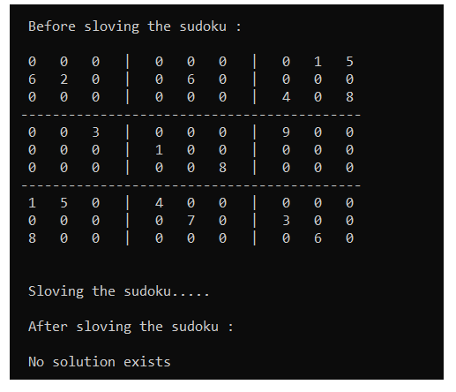
A test case where solution does not exists :

Slide 14
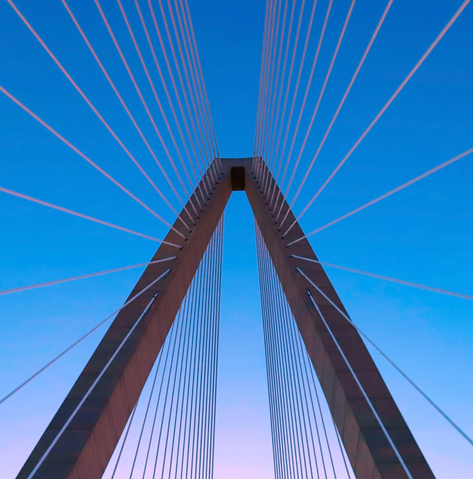
Conclusion
To solve the Wedding Seating Problem and Sudoku , graph coloring - a concept of discrete mathematics - comes into handy. Using graph coloring the imaging and finding solutions to the above mentioned problems can be easily done. Similarly, many real life applications such as time scheduling and register allocation is done using this wide concept of graph coloring FUTURE WORK would be to include more criteria for the WSP like equal number of guests per table, families and close relations together etc.

Slide 15




Contributions :
Research and ideas for the project :
1) Kausthub TM 3) Puttaraja
2) Neeraj Mirji 4) Sohanraj R
Report and PPT :
PPT : Kausthub TM, Neeraj Mirji
Report : Puttaraja, Sohanraj R
Coding and documentation :
Kausthub TM 3) Puttaraja
Neeraj Mirji 4) Sohanraj R
Co-ordination :
1) Kausthub T M

